Slide 2
W Women’s
I Initiative
S Supporting
E Entrepreneurship

Slide 3
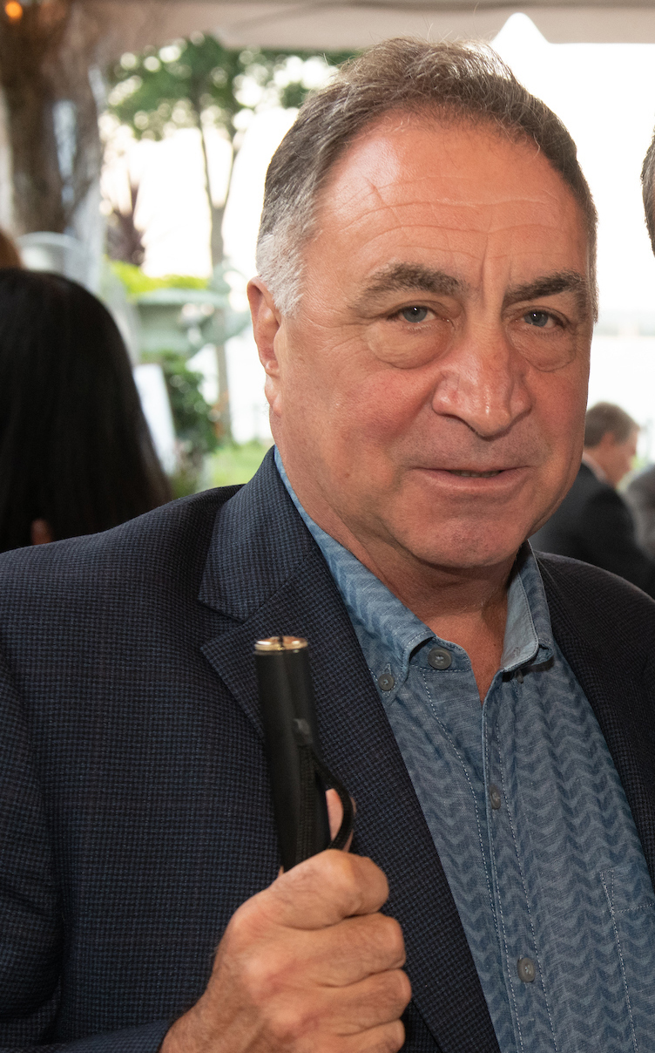
THE BEGINNING
Created in December, 2017 by NABM
President Nicky Gacos
Two Surveys
BEP Directors
Elected Committee Chairs
Collected Data from 100% of the SLA’s

Slide 4
THE DATA
The Numbers Don’t Lie
24% of Licensed Blind Vendors are Women
25% of Committee Members are Women
11 States Report No Women on Their Elected Committees
25% of Trainees are Women
36% of Small Businesses in the U.S. are Women Owned Which is Almost 50% Higher Than Randolph-Sheppard

Slide 5
What About the Big $$$ Facilities
Only 12.8% of Troop Dining Contracts Are Managed By Women
Of the Top 8 Traditional Retail Facilities in the U.S., NONE Are Operated by Women

Slide 6
Regional Differences
First Place Winner
Mountain States – 36%
Colorado, Montana, North Dakota, South Dakota, and Utah
Trailing the Pack
Plains States – 11%
Iowa, Nebraska, Kansas, and Missouri

Slide 7
Why? There Must Be An Explanation Let’s Look at Some Possibilities

Slide 8
Vocational Rehabilitation
The VR Counselor
Lack of Training
Poor Understanding of BEP and What the Job Entails
Pressure to Get Quick Closures
Gender Bias

Slide 9
Cumbersome and Lengthy Process to Get Trained, Licensed and Placed
May Take Years
No Available Avenue for Qualified Candidates Who Do Not Need VR Services
The Law Does Not Require a Potential Blind Vendor to Go Through VR but Most States Require It
Order of Selection
Begin VR Process
Training
Placement

Slide 10
Old Timers Cornered the Market
The Vendor Population is Aging. When Many Started, Women Were Not as Well Represented in the Labor Market, Therefore More Men Entered the Program Than Women
50 Years Ago 30% of the Workforce Consisted of Women
Today that Number Has Increased 46%
But This Does Not Explain the Low Percentage of Female Trainees

Slide 11
Family Commitments The Great Care Chasm
Society has changed but women assume greater responsibility for childcare and taking care of aging and ill family members which makes it difficult to go away for months of training and/or to relocate.
Lack of affordable daycare makes it impossible for some women to work especially since they usually have to start out in smaller earning facilities.
Requirements that the vendor be on-site specific hours with little flexibility.
Seniority based promotion rules make it impossible to get higher paying positions which make it difficult for women to give up their responsibilities at home to go to work.

Slide 12
Nature of the Job
Labor statistics suggest that women are not generally attracted to jobs in the vending industry.
Do they see the job as loading vending machines as opposed to owning a business?
Are VR Counselors telling prospective vendors about the various jobs as opposed to the opportunity to own a business and be their own boss?

Slide 13
Discrimination
Who generally makes decisions about entry into the BEP Program?
Answer:
BEP Directors and Committee Members in most cases
What is the gender of most BEP Directors and Committee Members?
Answer:
Men
DISCRIMINATION DOES EXIST IN THE WORKPLACE

Slide 14
How Do We Fix It?

Slide 15
EDUCATION
Educate VR Counselors
2. Utilize the Hadley Training for New Trainees
33% of Hadley Trainees are Women
Only 20% of Trainees in Traditional Classes are Women
Include Training on Women’s Issues in State Annual Training Conferences and National Conference
Hold a National Women’s Retreat/Symposium
a. If your state subscribes to NABM’ services, we can possibly provide a presentation at your state training conference

Slide 16
Marketing
1. Develop Special Marketing Tools for Women
2. Create a WISE YouTube Channel
3. Devote a Webinar Utilizing the NABM/Hadley Randolph-Sheppard on the Web Service
Social Media
Webinars

Slide 17
Mentoring
Create a List Serve for Women Blind Entrepreneurs
Hold Quarterly Wise Calls
Develop a Network of Women Entrepreneurs to Serve as Mentors and Resources for Prospective Candidates

Slide 18
Rules and Policies
Revise State Rules and Policies to Offer More Flexibility in Hours Required to be On-Site at a Vending Facility
Minimize or Eliminate Seniority in Promotions
Eliminate the Requirement that All Referrals Come From VR
Explore Ways to Offer Incentives Such as Daycare

Slide 19
RECOGNITION
Create Awards on State and National Levels That Recognize the Achievements of Women Blind Entrepreneurs
RRERECOGITION

Slide 20
NABM Recognizes that recruitment is not an issue isolated to women. We must do a better job of recruiting potential vendors regardless of gender. It is undeniable that women face unique barriers and we believe that many of the recommendations contained in our white paper will help recruit higher caliber candidates both male and female.
Not Just A Gender
Problem

Slide 21
STEP #1
ACKNOWLEDGE THERE IS A PROBLEM

Slide 22
Visit
www.blindmerchants.org

